Slide 1

COVID Response – Partnership Collaboration Visualisations

Slide 2
Introduction
The Project
To create one or a series of visualisations, showing that the Alan Turing Institute is a national hub for data science projects helping to shape the UK pandemic response.
They should specifically demonstrate that throughout the evolution of the pandemic, the Turing both directly provided specialist data science expertise, and enabled the collaboration of academic and non-academic partners on projects.
The intended audiences for these visualisations include, but are not limited to, the REG, the Alan Turing Institute more widely, partners, and government.
The next steps
The following five slides include concept visualisations and the dummy data needed to generate and maintain these.

Slide 3
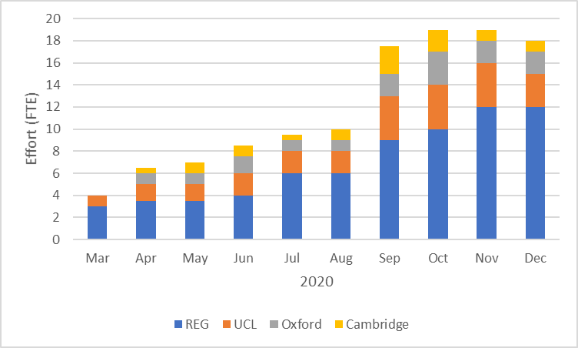
1. Partner effort by month – stacked column
Sketch
Dummy data
Partner/contributor (name)
Start date (week/month)
End date (week/month)
Effort (FTE in 0.5 increments)

Slide 4
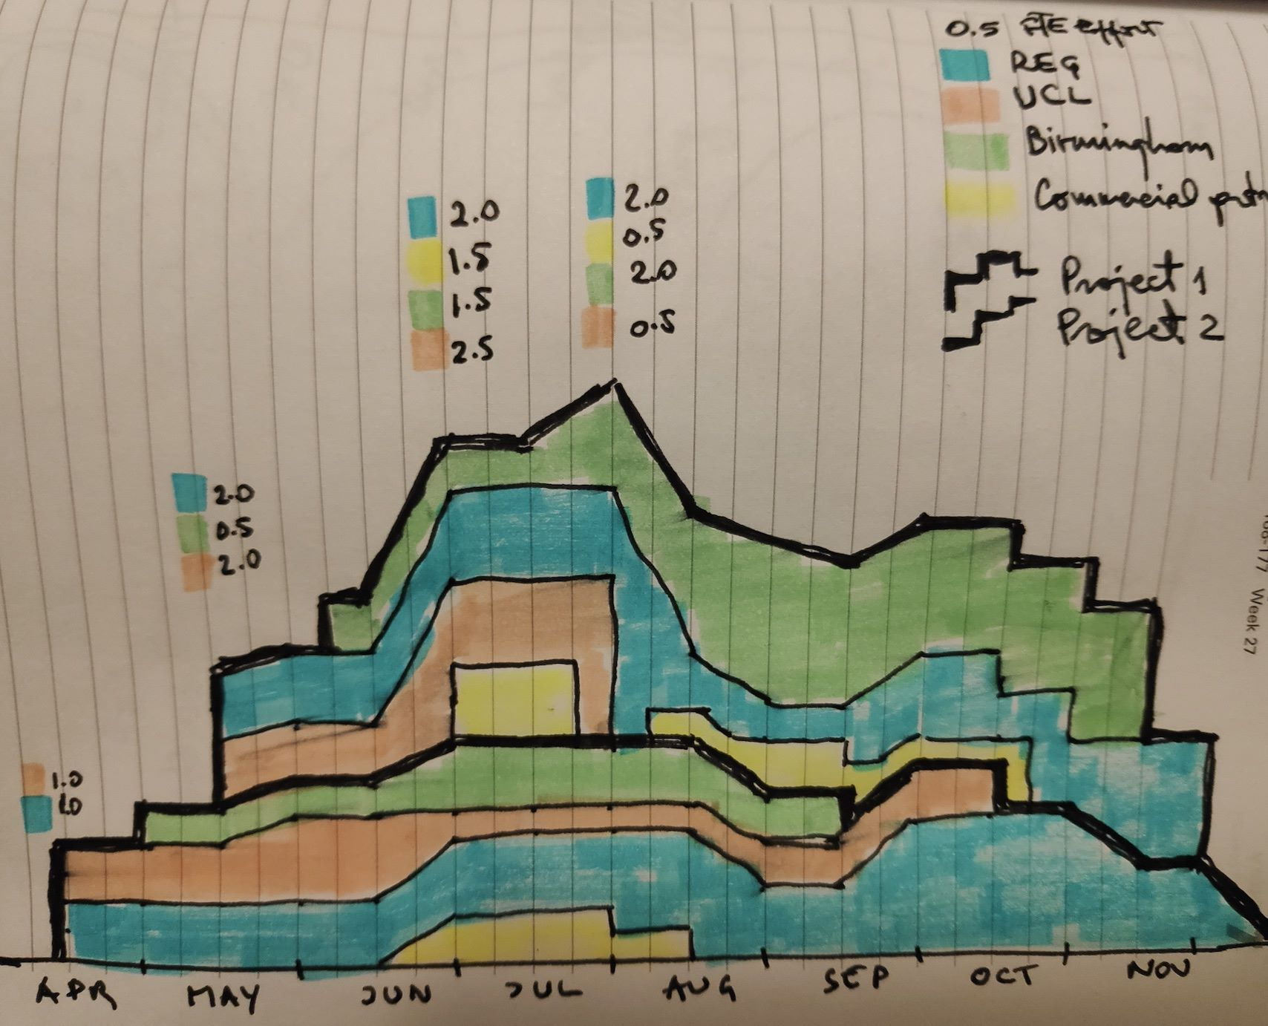
2. Partner effort by project timeline – stacked area
Sketch
Dummy data
Partner/contributor (name)
Project (name)
Start date (week/month)
End date (week/month)
Effort (FTE in 0.5 increments)

Slide 5
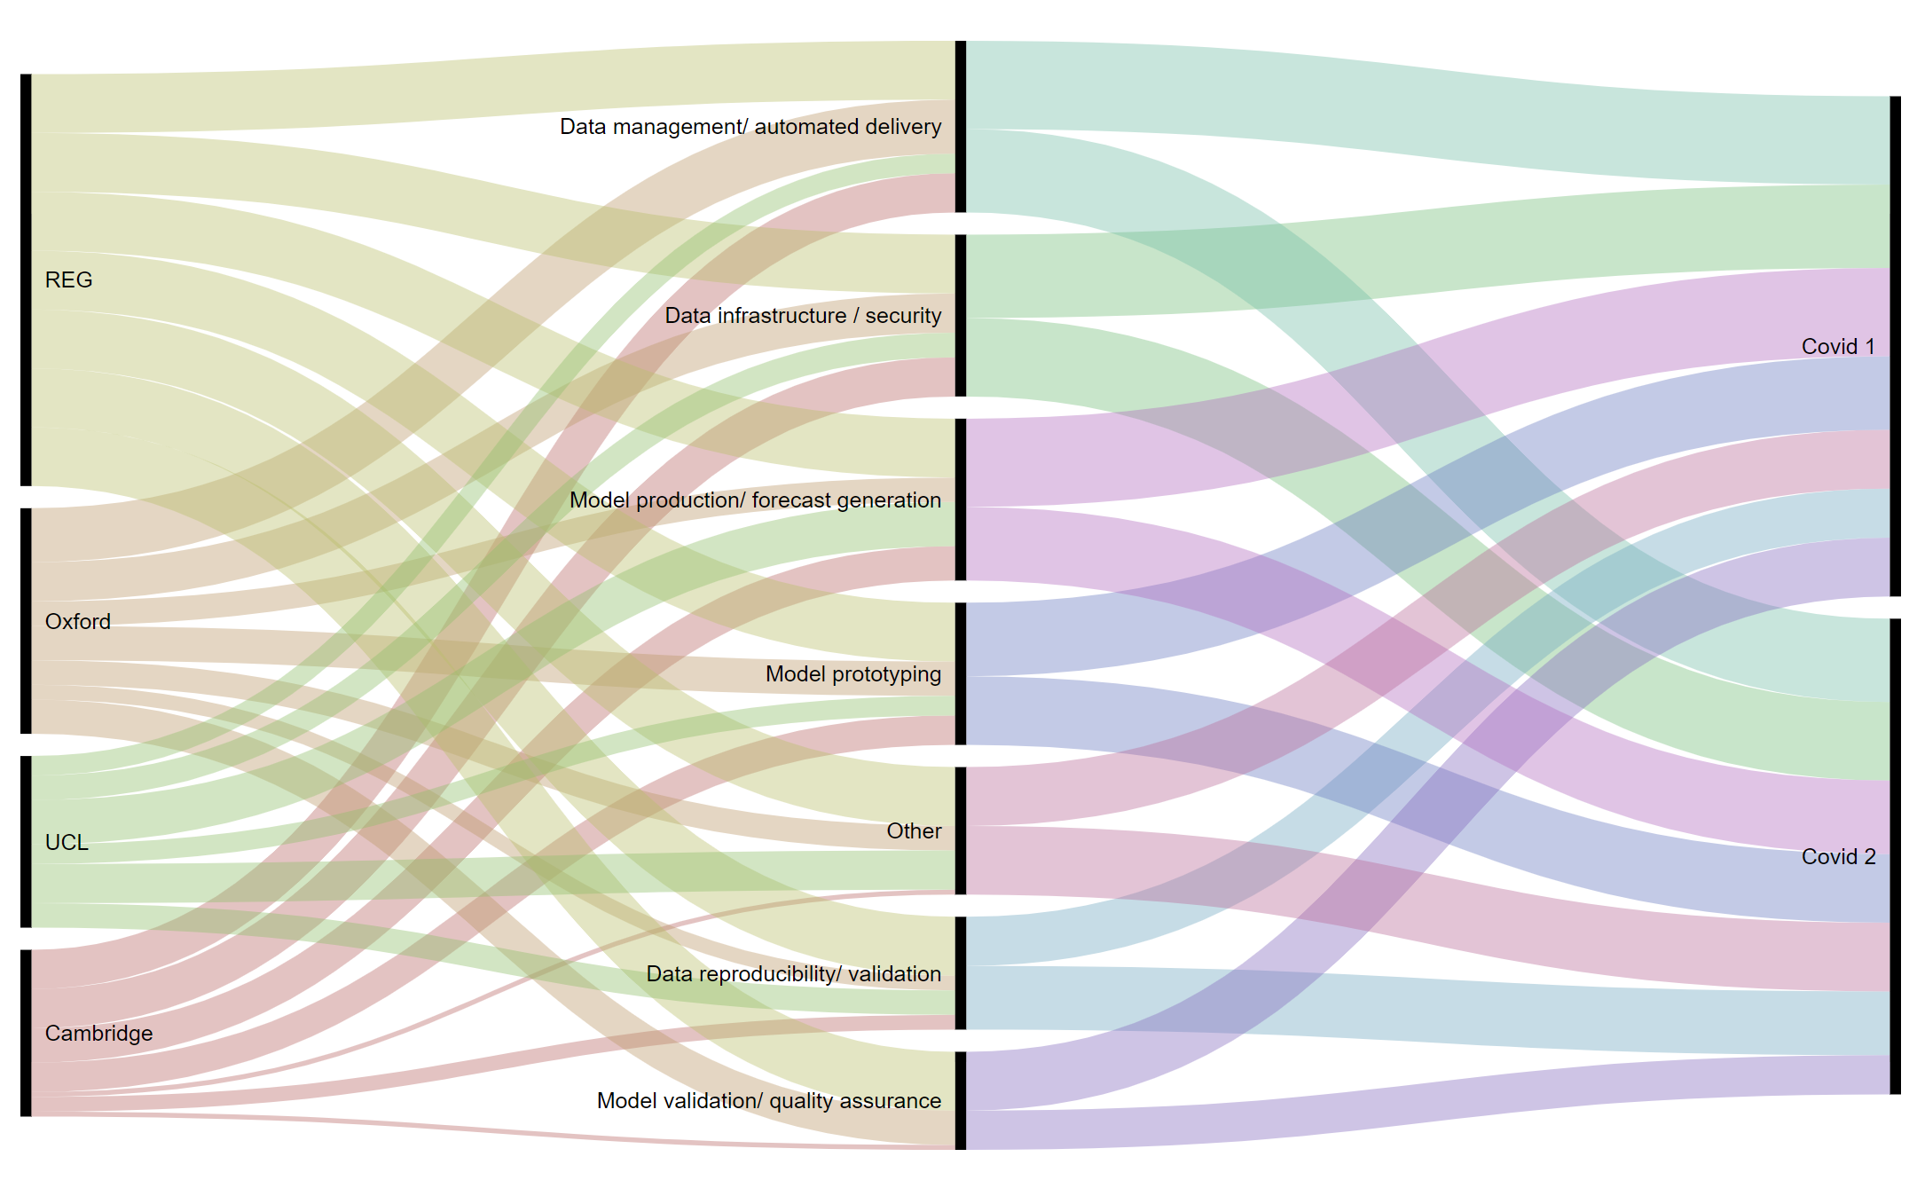
3. Task/effort/partner/project distribution - alluvial
Sketch
Dummy data
Partner/contributor (name)
Project (name)
Task (name)
Effort (FTE in 0.5 increments)

Slide 6
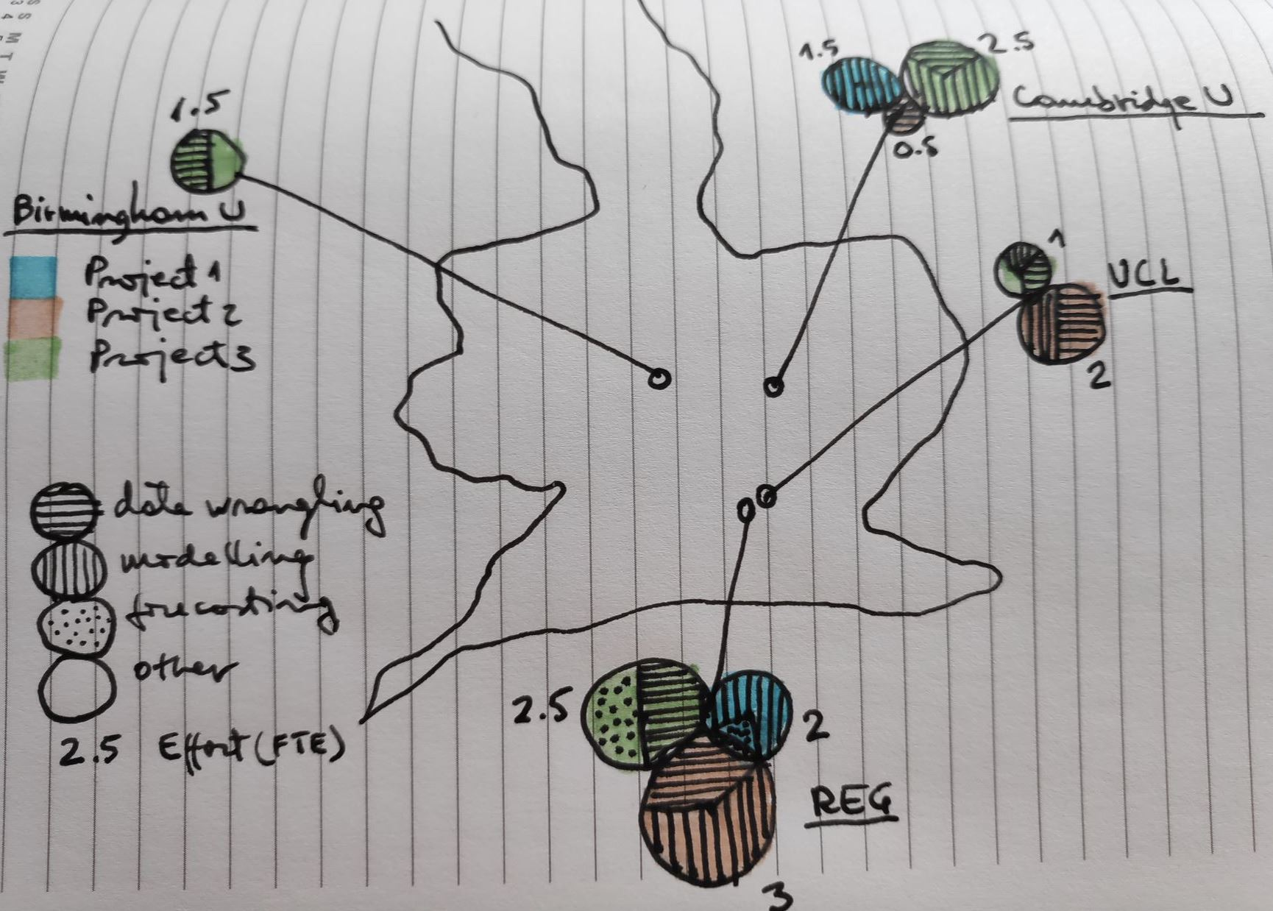
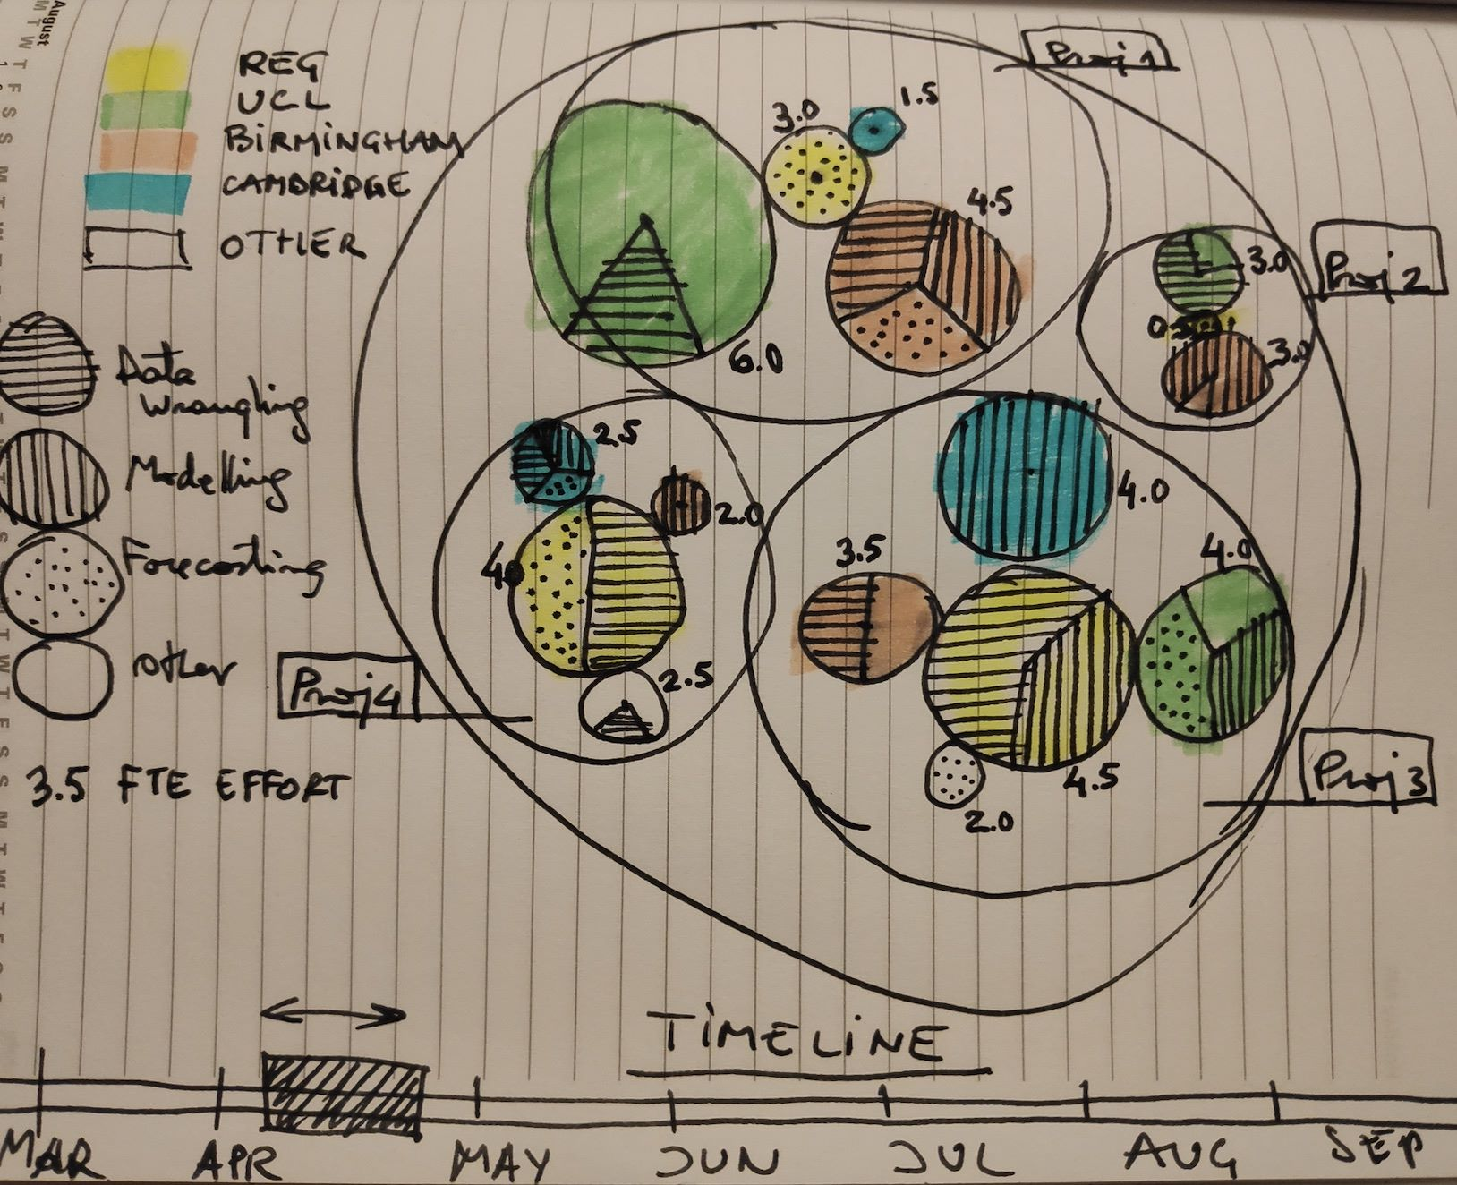
4. Task effort by partner/project – geo map / packed circles
Dummy data
Sketch
Time
Partner/contributor (name)
Partner location (postcode)
Project (name)
Task (name)
Start date (week/month)
End date (week/month)
Effort (FTE in 0.5 increments)

Slide 7
Questions
Are there any other visualisations you feel would also or better convey the key message?
Are there any additional datasets that would be able to further inform the visualisations?
What data would be needed in order to accurately generate each of these visualisations?
Where should the completed products be hosted to allow for sharing both internally and externally?
What tools should be used to create and maintain the visualisation?
How could we automate each to ensure they remain updated with the latest information?

